Slide 1

Homelessness 101 Training
Presented by Allyson Baptiste, MSW
(Greater Bakersfield Legal Assistance, Inc. Community Homeless Law Center Project)
abaptiste@gbla.org

Slide 2
Video: What It’s Like to Be Homeless: In Their Own Words
https://www.youtube.com/watch?v=xYCFJ965mFI

Slide 3
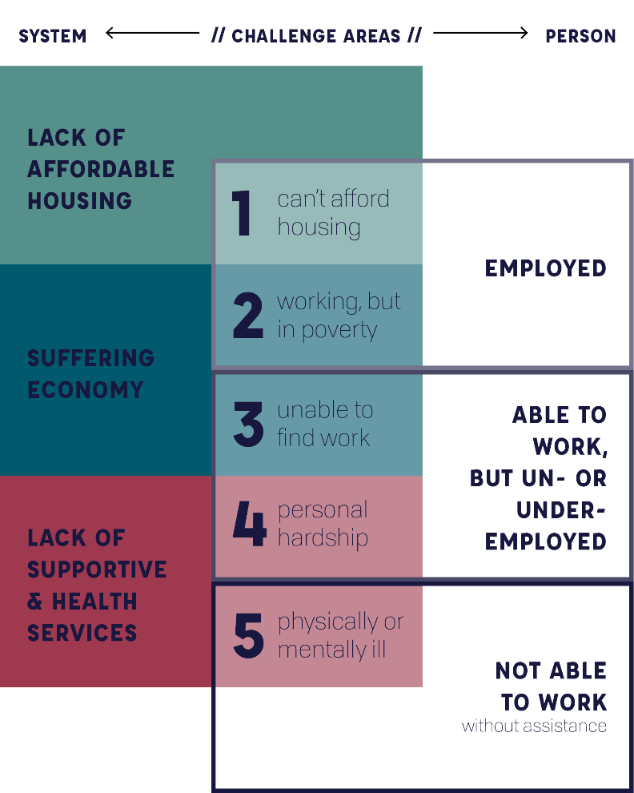
Causes of Homelessness “THERE’S A WIDE RANGE OF REASONS WHY SOMEONE MIGHT BE HOMELESS. CAUSES OF HOMELESSNESS ARE COMPLEX TO UNTANGLE, BUT IT COMES DOWN TO CONFLICT BETWEEN SYSTEM AND INDIVIDUAL.” http://www.understandhomelessness.com/

Slide 4
Housing and Urban Development (HUD) has SPECIFIC definitions of what defines “homeless”
These are NOT the same definitions as what the McKinney-Vento Act (that’s used in schools) uses when describing “homeless”

Slide 5
Homeless programs that are funded with HUD money are MANDATED to use the HUD definitions of homelessness when determining eligibility of people for their programs This means that sometimes homeless youth/ families may not be eligible for some HUD-funded programs, even if they are considered “homeless” under the McKinney-Vento Act
SOME examples of agencies in Kern County that are HUD-funded for their HOMELESS programs include the Housing Authority, Greater Bakersfield Legal Assistance, Bakersfield Homeless Center, Flood Ministries, Alliance Against Family Violence & Sexual Assault, Kern’s Coordinated Entry System (run by CapK 2-1-1)

Slide 6
HUD’s 4 Categories of “Homeless”
Literally homeless;
Imminent risk of homelessness;
Homeless under other Federal statutes; and
Fleeing/attempting to flee domestic violence

Slide 7
Category 1: “Literally homeless” is defined by HUD as:
People who are living in a place not meant for human habitation, in emergency shelter, in transitional housing, or are exiting an institution where they temporarily resided. The only significant change from existing practice is that people will be considered homeless if they are exiting an institution where they resided for up to 90 days (it was previously 30 days), and were in shelter or a place not meant for human habitation immediately prior to entering that institution.

Slide 8
Category 2: “Imminent risk of homelessness” is defined by HUD as:
People who are losing their primary nighttime residence, which may include a motel or hotel or a doubled up situation, within 14 days and lack resources or support networks to remain in housing. HUD had previously allowed people who were being displaced within 7 days to be considered homeless. The proposed regulation also describes specific documentation requirements for this category.
This means you must prove you will be homeless within 14 days AND have no means of finding alternative housing.
For example:
Client A is court-ordered to vacate his property by July 12th, 2019. However, Client A will be receiving his SSDI check on July 10th, 2019 and will have enough funds to cover rent in a motel until his next SSDI check. Does client meet this definition of being at “imminent risk of homelessness”?

Slide 9
Category 3: “Homeless under other federal statutes” (AKA the most CONFUSING HUD category):
Families with children or unaccompanied youth who are unstably housed and likely to continue in that state. This is a new category of homelessness, and it applies to families with children or unaccompanied youth who have:
Not had a lease or ownership interest in a housing unit in the last 60 or more days,
Have had two or more moves in the last 60 days,
And who are likely to continue to be unstably housed because of disability or multiple barriers to employment.

Slide 10
“Well, Category 3 sounds like McKinney-Vento Act youth and families, right?”
Not exactly…..

Slide 11
Well first…. what is the McKinney-Vento Act?
“The McKinney-Vento Homeless Assistance Act (McKinney-Vento Act) (42 U.S.C. § 11431-11435) is federal legislation that ensures the educational rights and protections of children and youths experiencing homelessness.
It requires all local educational agencies (LEAs) to ensure that homeless students have access to the same free, appropriate public education, including public preschools, as provided to other children and youths. The McKinney-Vento Act defines LEAs as public school districts, direct-funded and locally funded charter schools, and county offices of education. The McKinney-Vento Act also authorizes the funding for the federal Education for Homeless Children and Youths Program.”
-California Dept. of Education

Slide 12
The McKinney-Vento Act defines homeless children and youths as individuals who lack a fixed, regular, and adequate nighttime residence. This definition also includes:
Children and youths who are sharing the housing of other persons due to loss of housing, economic hardship, or a similar reason
Children and youths who may be living in motels, hotels, trailer parks, shelters
Children and youths who have a primary nighttime residence that is a public or private place not designed for or ordinarily used as a regular sleeping accommodation for human beings
Children and youths who are living in cars, parks, public spaces, abandoned buildings, substandard housing, bus or train stations, or similar settings, or
Migratory children who qualify as homeless because they are children who are living in similar circumstances listed above

Slide 13
So McKinney-Vento youth MAY be able to fit into HUD’s Category 3, IF they not only meet the Category 3 definition but ALSO meet the McKinney-Vento Act definition of “homeless.”
Oh, and one more thing…..
HUD doesn’t allow just anyone to use funding for Category 3.
HUD requires that Continuum of Care’s (CoC’s)--- AKA Kern County’s Homeless Collaborative--- ask for special permission to use HUD funds to pay for homeless youth that count under Category 3. And even if the CoC obtains that special permission, the CoC still cannot use more than 10% of their HUD funds to pay for those that fall under Category 3’s definition of homelessness.

Slide 14
Currently, Kern County’s CoC does not have special permission to spend HUD funds on homeless individuals that fall under Category 3.
So sometimes a family or youth may be considered “homeless” through the youth’s school district via the McKinney-Vento Act, but the family may not be eligible for homeless resources through HUD-funded homeless programs, due to the tricky Category 3 definition of homelessness.

Slide 15
Category 4:
“Fleeing/ attempting to flee domestic violence” is defined by HUD as:
“People who are fleeing or attempting to flee domestic violence, have no other residence, and lack the resources or support networks to obtain other permanent housing. This category is similar to the current practice regarding people who are fleeing domestic violence.”

Slide 16
Now that we’ve learned HUD’s federal definitions of homelessness, let’s throw some even more complicated HUD-based terminology at you…..

Slide 17
HUD’s national goal is to end homelessness.
But what does “ending homelessness” mean?
“An end to homelessness does not mean that no one will ever experience a housing crisis again.
Changing economic realities, the unpredictability of life, and unsafe or unwelcoming family environments may create situations where individuals, families, or youth could experience or be at risk of homelessness.
An end to homelessness means that every community will have a systematic response in place that ensures homelessness is prevented whenever possible or is otherwise a rare, brief, and non-recurring experience.”
-The United States Interagency Council on Homelessness (USICH)

Slide 18
Qualifying disabilities:
A diagnosable substance abuse disorder
A serious mental illness
A developmental disability
A chronic physical illness or disability
HUD’s current main two goals are to end both chronic homelessness and veteran homelessness in communities.
A “chronically homeless” individual is defined as:
An individual living with a disability
Living in a place not meant for human habitation, a safe haven, or in an emergency shelter; and
Has been homeless continuously for at least 12 months or on at least 4 separate occasions in the last 3 years where the combined occasions must total at least 12 months
Occasions separated by a break of at least seven nights
Stays in institution of fewer than 90 days does not constitute a break

Slide 19

One last and important HUD definition….
HUD requires all communities follow a “Housing First” model.
“Housing First is an approach to quickly and successfully connect individuals and families experiencing homelessness to permanent housing without preconditions and barriers to entry, such as sobriety, treatment or service participation requirements.
Supportive services are offered to maximize housing stability and prevent returns to homelessness as opposed to addressing predetermined treatment goals prior to permanent housing entry.”
--The United States Interagency Council on Homelessness (USICH)

Slide 20
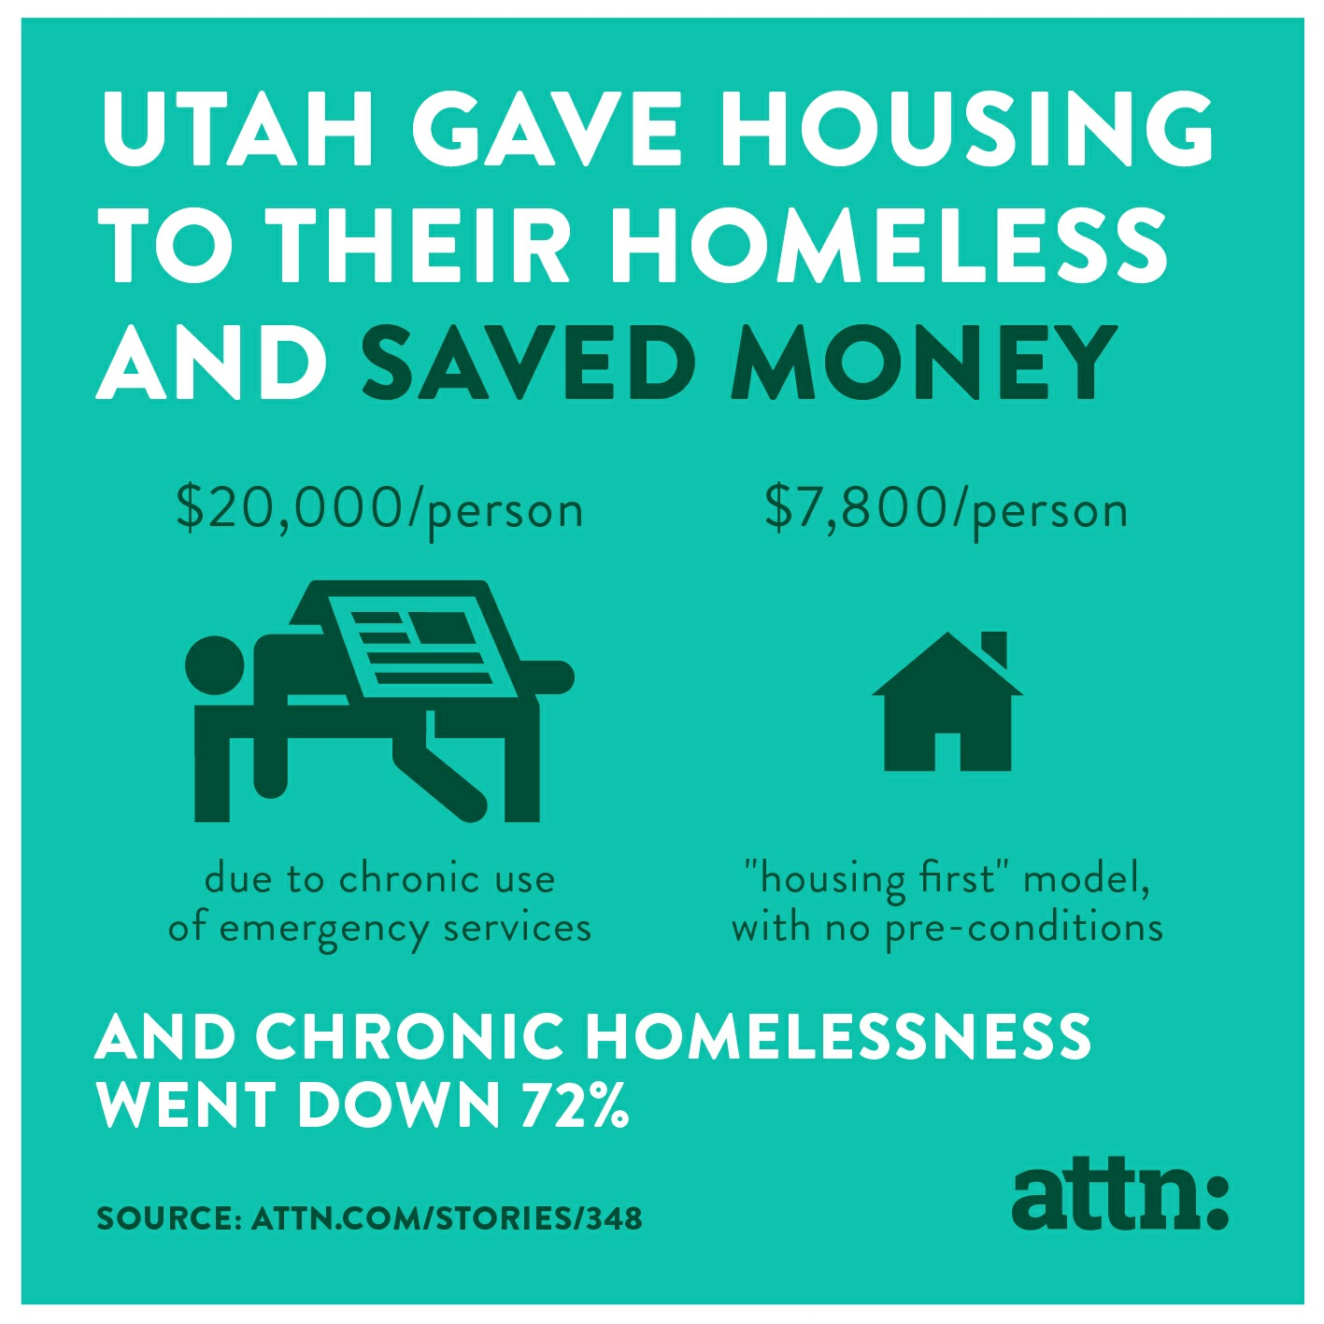
State of Utah’s cost effectiveness results utilizing the “Housing First” Model in 2014

Slide 21
Kern County’s 2016 Cost Benefit Analysis shows that Kern County saves $28,000 per person, per year when the Housing First Model is used!

Slide 22

Congratulations!
Now you know a lot more about the federal laws regarding homelessness!
Be proud of yourself– it’s very complicated!
For even more detailed info or resources RE: homelessness, you can visit the HUD Exchange at: https://www.hudexchange.info/homelessness-assistance/

Slide 23

One last thing….
If you encounter an individual experiencing homelessness and want to help them get housed, have them call 2-1-1! 2-1-1 manages the housing list for Kern County (called the Coordinated Entry System), that connects homeless individuals to housing resources (such as Rapid Rehousing, housing vouchers, etc.)
2-1-1 is the best place to refer the individual, as CapK/2-1-1 can also help refer them to agencies to get their other needs met (i.e. medical, legal, emergency shelter, education, utility assistance, food, etc.)

Slide 24
If you are looking for more information on the Bakersfield-Kern Regional Homeless Collaborative, please visit:
Endkernhomeless.org
BKRHC MISSION
Our Mission is to put an end to homelessness in Kern County through collaborative planning and action. The BKRHC is designated as the Bakersfield / Kern County CA-604 Continuum of Care, designed to promote community-wide commitment to the goal of ending homelessness; provide funding for efforts by nonprofit providers, and state and local governments to quickly rehouse homeless individuals and families. Together we are a collective action, committed to ending homelessness. The members of the BKRHC strives towards “housing first”. When people are housed first basic needs are met faster, helping them live independently and minimizes the costs to communities.
Thank you!

